Slide 1
Business Process Modelling
Prof. Marcello La Rosa
BPM Discipline
Queensland University of Technology

Slide 2
Quick recap from Week 4
What is the difference between data objects and data stores?
What is the difference between pools and lanes?

Slide 3
Process decomposition and reuse in BPMN

Slide 4
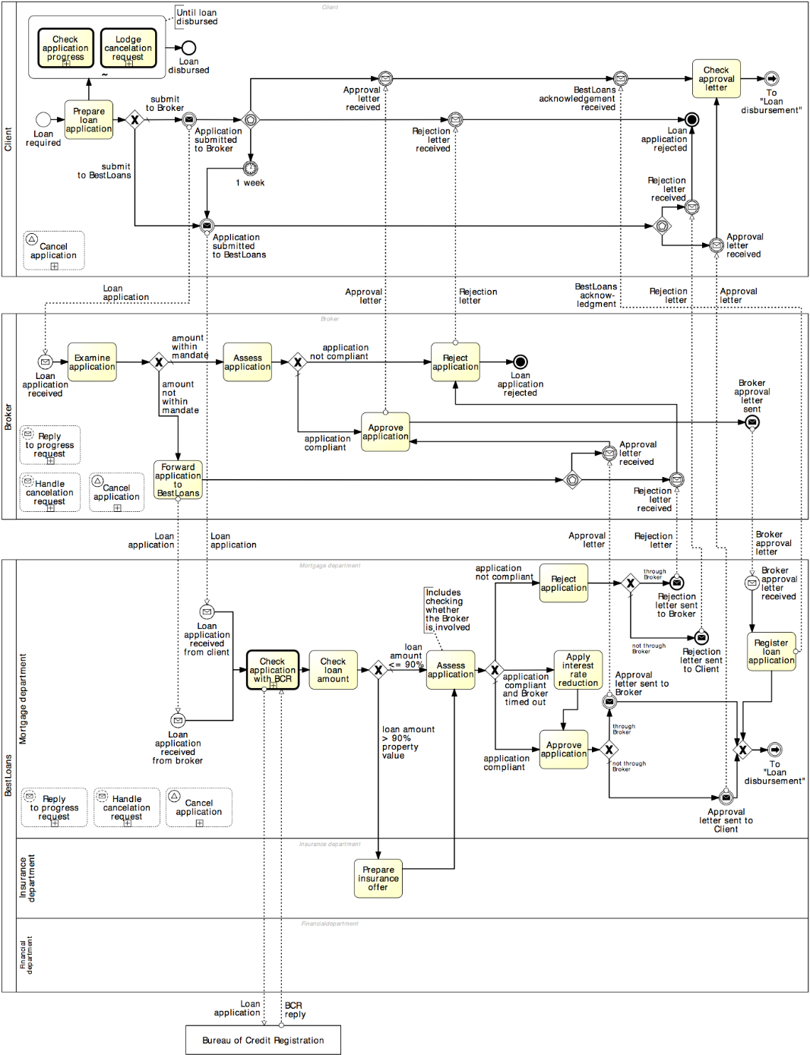
Process decomposition

Slide 5
Process decomposition
An activity in a process can be decomposed into a “sub-process”
Use this feature to:
Improve understanding by breaking down large models
Identify parts that should be:
repeated
executed multiple times in parallel
interrupted, or
compensated
Activities

Slide 6
Example: Sub-Process

Slide 7
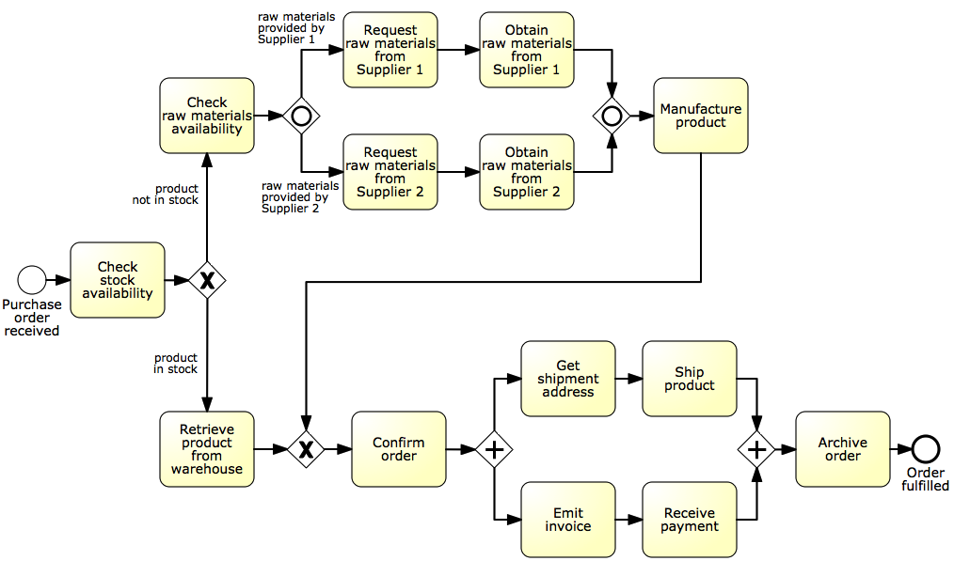
Identify possible sub-processes
Acquire raw materials
Ship and invoice

Slide 8
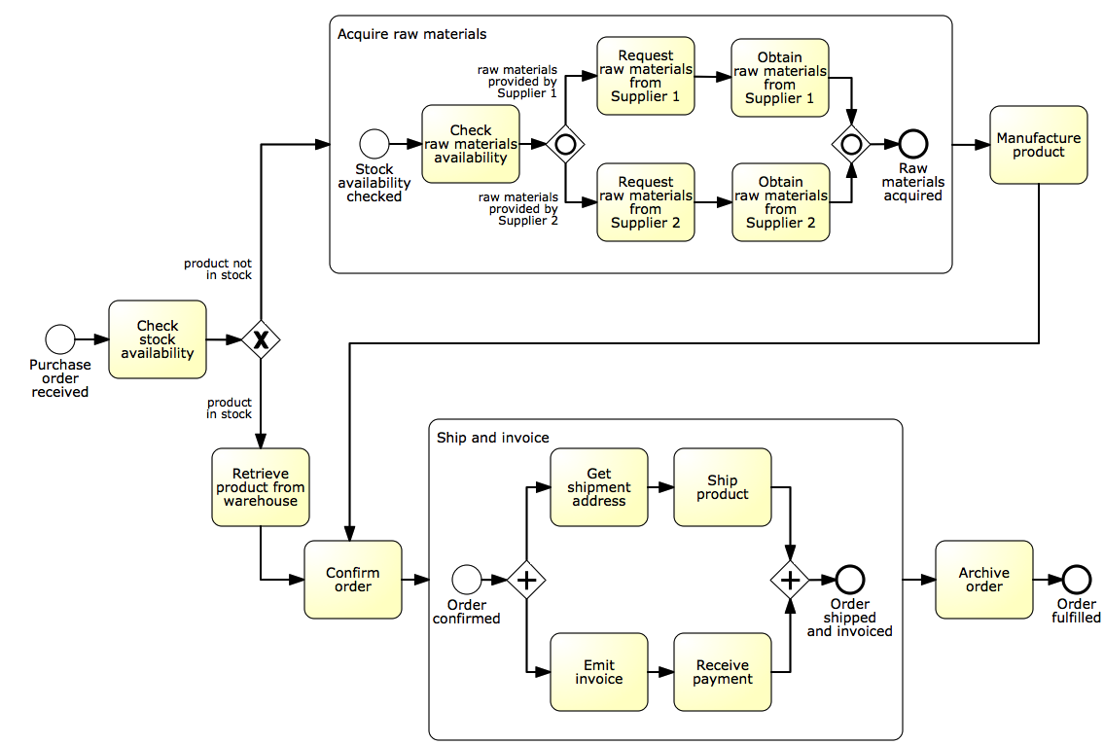
Solution

Slide 9
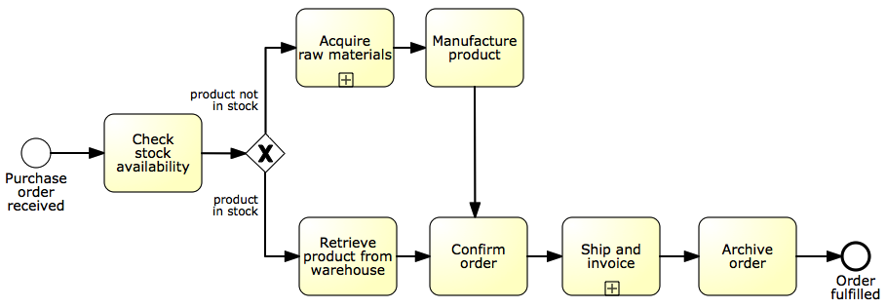
The refactored model

Slide 10
Example: Modelling process hierarchies
(Fragment of the SCOR reference model)

Slide 11
Value chain modelling
Chain of (high-level) processes an organisation performs in order to achieve a business goal, e.g. deliver a product or service to the market.
Business
process
“is predecessor of”

Slide 12
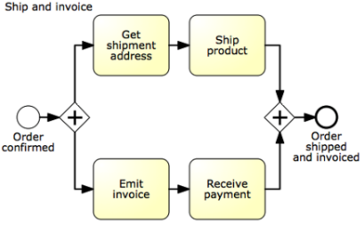
Linking value chains with process models
Process model for this process is available

Slide 13
When should we use sub-processes?

Slide 14
Guidelines: modeling levels
Use sub-processes when the model becomes too large:
Hard to understand
Increased error probability
Level 1 – start with value chain
Level 2 – add main decisions and handoffs (lanes)
Level 3+ – add procedural aspects:
Parallel gateways
Data objects, data stores
Exception handling
And as much detail as is relevant
Decomposition drivers:
Logical: group elements meaningfully (e.g. common business object)
Structural: up to 30 nodes (activities, events, gateways)

Slide 15
Process Reuse
By default, a sub-process is “embedded” into its parent process (i.e. it is stored within the same file)
In order to maximize reuse, it is possible to “extract” the sub-process and store it as a separate file in the process model repository
Such a sub-process is called “global” model, and is invoked via a “call” activity
(normal)
activity
Call activity

Slide 16
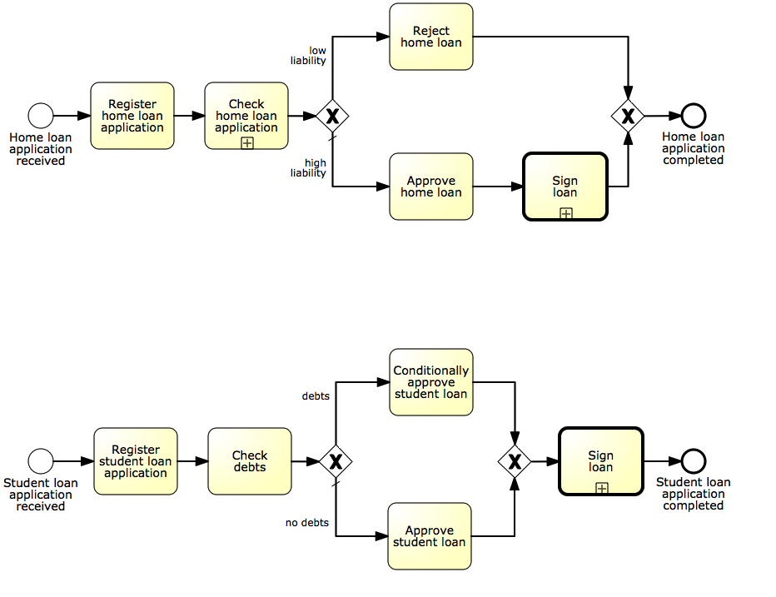
Example: process reuse
Call activity is the default choice to maximize reusability

Slide 17
Sub-processes: syntax
Sequence flows cannot cross sub-process boundaries
Use start/end events
Message flows can cross sub-process boundaries
To indicate messages emanating from/incoming into the sub-process
Start with at least one start event
If multiple, first occurring will trigger the sub-process
Finish with at least one end event
The sub-process will complete once all tokens have reached an end event. May need an (X)OR-split after sub-process to understand what end event(s) have been reached

Slide 18
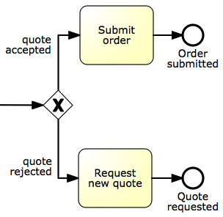
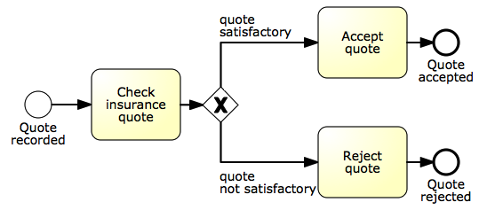
Example: sub-process with multiple end events
Quote-to-order

Slide 19
Process reuse

Slide 20
Process reuse
By default, a sub-process is “embedded” into its parent process (i.e. it is stored within the same file)
In order to maximize reuse, it is possible to “extract” the sub-process and store it as a separate file in the process model repository
Such a sub-process is called “global” model, and is invoked via a “call” activity
(normal)
activity
Call activity

Slide 21
Example: process reuse
Call activity is the default choice to maximize reusability

Slide 22
Sub-processes: syntax
Sequence flows cannot cross sub-process boundaries
Use start/end events
Message flows can cross sub-process boundaries
To indicate messages emanating from/incoming into the sub-process
Start with at least one start event
If multiple, first occurring will trigger the sub-process
Finish with at least one end event
The sub-process will complete once all tokens have reached an end event. May need an (X)OR-split after sub-process to understand what end event(s) have been reached

Slide 23
Example: sub-process with multiple end events
Quote-to-order

Slide 24
More on rework and repetition

Slide 25
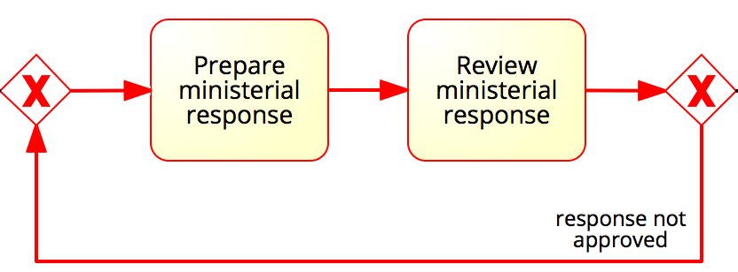
More on rework and repetition
XOR-join: entry point
XOR-split: exit point
Structured cycle (SESE component)

Slide 26
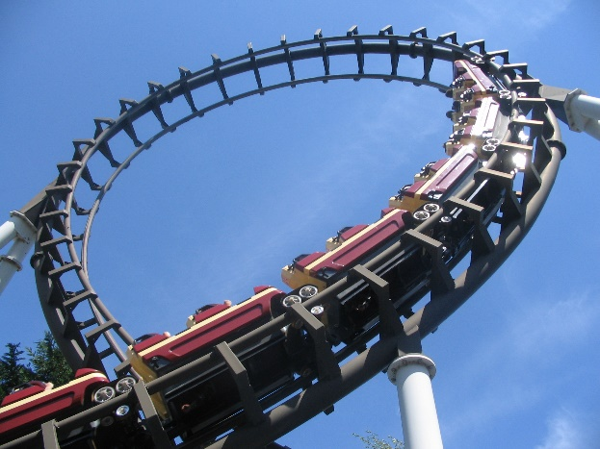
Block-structured repetition: Activity loop
BPMN also provides the Activity loop construct to allow the repetition of a task or sub-process

Slide 27
Example: block-structured repetition
Completion condition
Must have a decision activity

Slide 28
Loop activity or cycle?

Slide 29
Arbitrary Cycles
Arbitrary = unstructured, i.e. it can have multiple entry and exit points
entry point
entry point
exit point
exit point

Slide 30
Example: multi-instance activity
Procurement
In procurement, typically a quote is to be obtained from all preferred suppliers (assumption: five preferred suppliers exist). After all quotes are received, they are evaluated and the best quote is selected. A corresponding purchase order is then placed.

Slide 31
Solution: without multi-instance activity
Procurement

Slide 32
Parallel repetition: multi-instance activity
The multi-instance activity provides a mechanism to indicate that an activity is executed multiple times concurrently
Useful when the same activity needs to be executed for multiple entities or data items, such as:
Request quotes from multiple suppliers
Check the availability for each line item in an order separately
Send and gather questionnaires from multiple witnesses in the context of an insurance claim

Slide 33
Solution: with multi-instance activity
Procurement
cardinality

Slide 34
Further example: multi-instance activity
Motor insurance claim lodgement
After a car accident, a statement is sought from the witnesses that were present, in order to lodge the insurance claim. As soon as the first two statements are received, the claim can be lodged to the insurance company without waiting for the other statements.

Slide 35
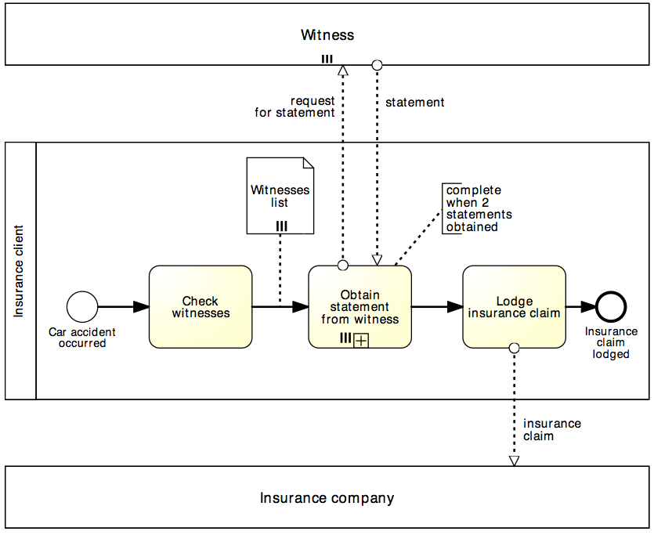
Solution: multi-instance activity
Motor insurance claim lodgement
Data collection denotes a set of data objects of the same type
(determines cardinality of multi-instance activity)
Multi-instance pool
denotes multiple participants of the same type
Completion condition indicates minimum number of instances required to complete
(≤ cardinality)

Slide 36
Uncontrolled Repetition: Ad-hoc sub-process
The ad-hoc sub-process contains activities to be executed in arbitrary order and number of times
May define order of sub-set of activities by sequence flow
Can be used in an early version of a process diagram when the order of execution is still unknown
Completion condition

Slide 37
Example: ad-hoc sub-process
Army recruitment
A typical army selection process starts by shortlisting all candidates’ applications. Those shortlisted are then called to sit the following tests: drug and alcohol, eye, color vision, hearing, blood, urine, weight, fingerprinting and doctor examination. The color vision can only be done after the eye test, while the doctor examination can only be done after color vision, hearing, blood, urine and weight have been tested. Moreover, it may be required for some candidates to repeat some of these tests multiple times in order to get a correct assessment, e.g. the blood test may need be repeated if the candidate has taken too much sugar in the previous 24 hours. The candidates that pass all tests are asked to sit a mental exam and a physical exam, followed by an interview. Only those that also pass these two exams and perform well in the interview can be recruited in the army.

Slide 38
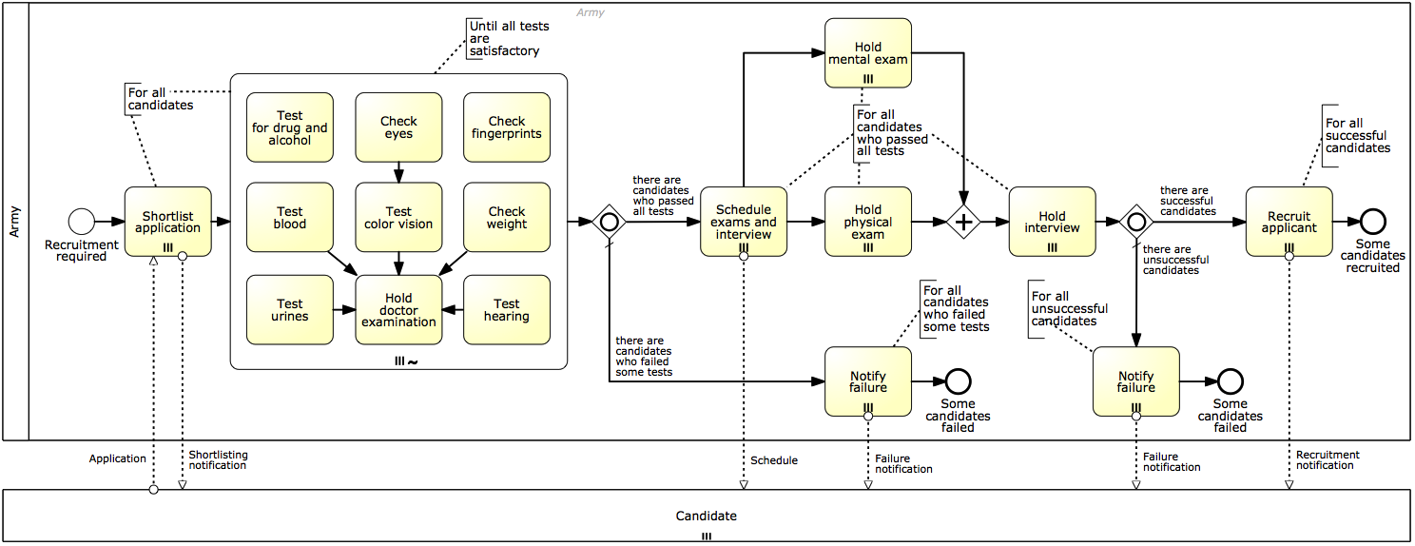
Solution: ad-hoc sub-process
Army recruitment

Slide 39
Readings for Week 5
Dumas M., La Rosa M., Mendling J., Reijers, H. (2013): Fundamentals of BPM. Chapter 4: 4.1-4.2

Slide 40
Prof. Marcello La Rosa IS School Academic Director (Corporate Programs and Partnerships) BPM Discipline, IS School
Science & Engineering Faculty Queensland University of Technology 2 George Street Brisbane QLD 4000 Australia
p +61 (0)7 3138-9482 e m.larosa@qut.edu.au w www.marcellolarosa.com

