Slide 1
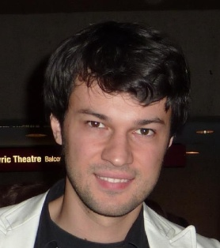
Your Unit Coordinator
A/Professor Marcello La Rosa
Academic Director (corporate programs and partnerships) for IS School
PhD in BPM
Over 60 refereed publications
Instructor in numerous BPM training seminars in Australia
Contributor to the Apromore and YAWL initiatives
Teaching areas: business process modelling and automation, service oriented architectures
More information: www.marcellolarosa.com
Consultation: (by appointment) m.larosa@qut.edu.au. First, approach your tutor.

Slide 2
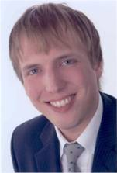
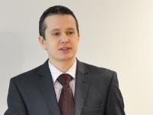
Your co-lecturers
Dr Thomas Kohlborn, Postdoctoral Research Fellow
t.kohlborn@qut.edu.au
Dr Artem Polyvyanyy, Postdoctoral Research Fellow
artem.polyvyanyy@qut.edu.au
Prof. Jan Recker, Woolworths Chair for Retail Innovation
j.recker@qut.edu.au
Notes:
2

Slide 3
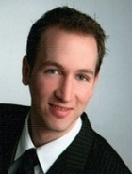
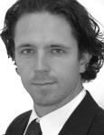
Your Tutors
Eike Bernhard (INB/INN)
Stephan Clemens (INB/INN)
PhD Candidate
eike.bernhard@qut.edu.au
Research Assistant
stephan.clemens@qut.edu.au

Slide 4
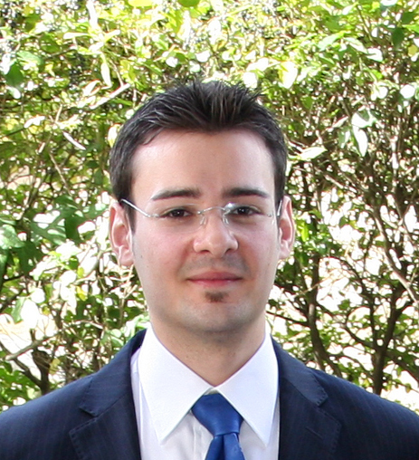
Your Tutors
Raffaele Conforti (INB)
Dr Jochen de Weerdt (INB)
PhD Candidate
raffaele.conforti@qut.edu.au
Postdoctoral Research Fellow
jochen.deweerdt@qut.edu.au

Slide 5
Unit Structure
Organisation of this subject
Positioning of Business Process Modelling
Objectives, Assessment, Resources
Principles of Modelling
Business process modelling languages
Foundations of process modelling: Petri Nets
Event-driven Process Chains (EPCs)
Business Process Model and Notation (BPMN 2.0)
Business process identification
Business process discovery methods
Managing process modelling projects

Slide 6
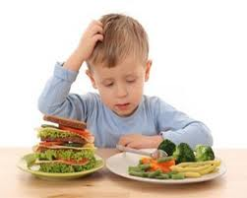
Unit Objectives
Develop general skills in conceptual modelling, analytical and system thinking
Develop team work
Provide insights into popular process modelling techniques (e.g. BPMN) and current tools (e.g. Signavio)
Provide modelling skills which complement the management-centred skills from INB/INN321, and the technical skills from INN323
Improve understanding of business-IT alignment

Slide 7
Business Process Management Curriculum
INB/N321
Business Process Improvement
INB/N320
Business Process
Modelling
INB/N324
Business Process Analytics
INN327
Business Process Management
INN326
Advanced Business Process Modelling
INN323
Business Process Automation
INN690 BPM Research Project
INN610
Case Studies in BPM
1 semester
2 semester

Slide 8
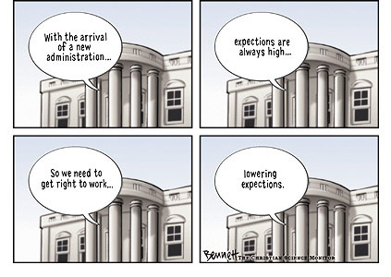
Questions / Expectations

Slide 9
Assessment
Assignment 1 (20%):
Model a simple business process scenario by using one or more process modelling languages
Demonstrate capability to deploy core modelling constructs
Assignment 2 (30%):
Model a complex business process scenario by using one or more process modelling languages and a variety of abstraction levels
Demonstrate capability to deploy advanced modelling constructs and to establish a governance structure
Exam (50%)

Slide 10
Assignment 1: Basic Business Process Modelling
Worth 20%
Available from end of Week 3
Individual or as team (up to 5 members)
Conduct process modelling for a simple scenario
Focus: build high-quality process models and present the results (not about process improvement)
INN students: Also use EPCs and compare EPCs/BPMN
Deadline: 20 September (Week 9)

Slide 11
Assignment 2: Advanced Business Process Modelling
Worth 30%
Available from end of Week 9
Individual or as team (up to 5 members)
Conduct process modelling for a complex scenario
Focus: understand and model complex scenarios at various levels of abstraction for various audiences
INN students: Also discuss governance (process architecture and modelling conventions)
Deadline: 1 November

Slide 12
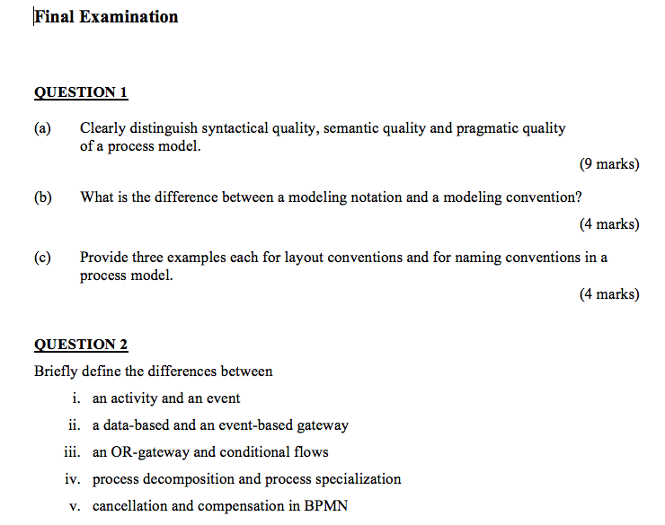
Exam
50%
3 hours
During exam period
Different for INB/INN
See extract of previous exam on blackboard
(no solutions available, please don’t ask)

Slide 13
Tutorials (From Week 2)
Focus: exercises, exercises, exercises...
Expectation: that you do the exercises at home, like in the old school days
Time | Mon | Tue | Wed | Thu | Fri
9am |  | S502
10am |  |  | S518
11am
12am
1pm |  | S506 |  | S503, S506
2pm |  |  |  | S507
3pm |  |  |  | S410 (CLASS)
4pm |  |  |  | S410 (CLASS)
5pm
6pm
7pm
8pm |  |  | S503 (INN) | S503 (INN)

Slide 14
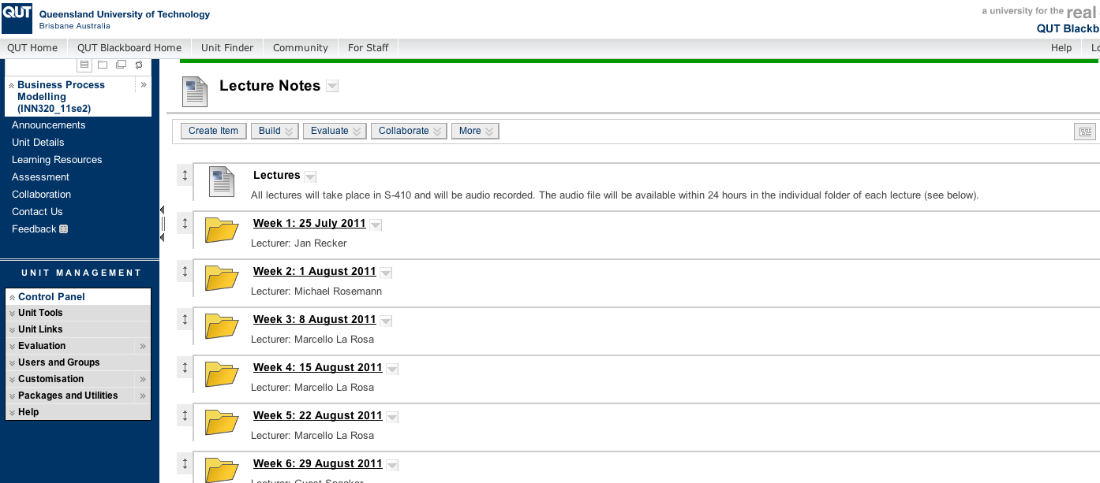
INB320 Blackboard Page
INN320 students redirected to INB page

Slide 15
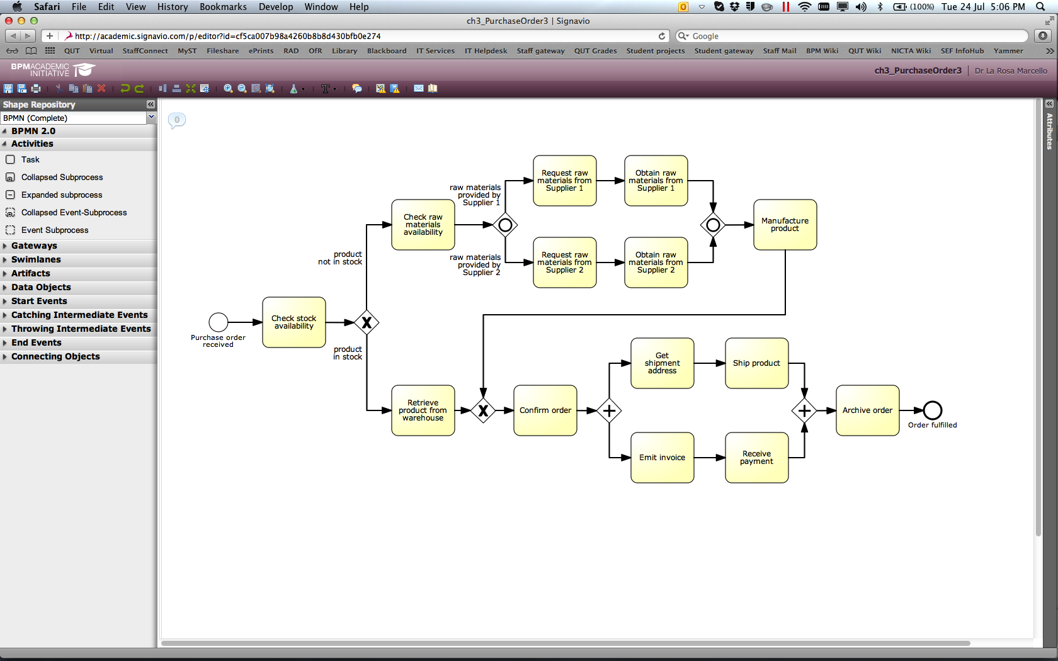
Our modelling tool: Signavio Academic Initiative http://academic.signavio.com

Slide 16
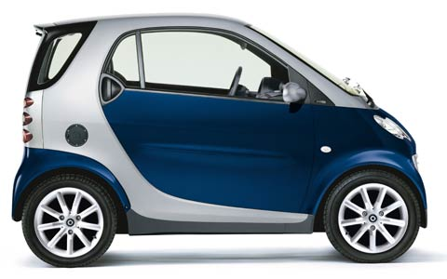
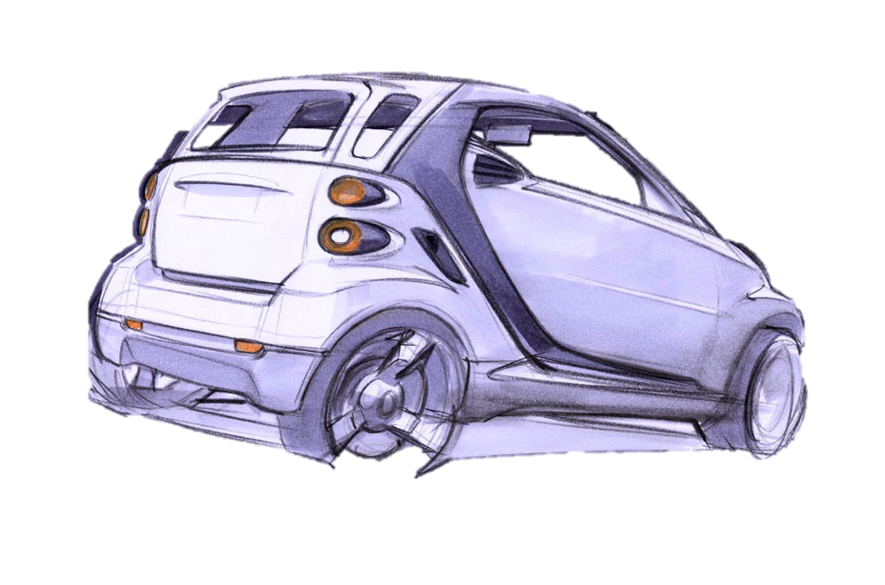
Let’s get back to business…

Slide 17
Model Definition
A model is a representation of some phenomenon of the real world made in order to facilitate an understanding of its workings. A model is a simplified and generalized version.
What phenomenon matters?
How to represent this?
How to facilitate understanding?

Slide 18
Basic modelling principles: Systems Theory
System
Element
External Element
Relationship

Slide 19
Systems
Units of analysis, determined by the system boundaries
One element can belong to many systems and a system is made out of many elements
Interacts with (impacts and is impacted by) the system environment
Example systems:
Family
Company
Country

Slide 20
Elements
An element is an entity of the system, e.g.
Piace of data
Employee
Building
IT resource
Elements (instances) can be classified to element types (Marcello → A/Professor; A/Professor → Employee)
Various semantic relationships exist between elements

Slide 21
Semantic relationships
Specialization
Aggregation
Composition
Predecessor
Successor
Hierarchical relationships
Order relationships

Slide 22
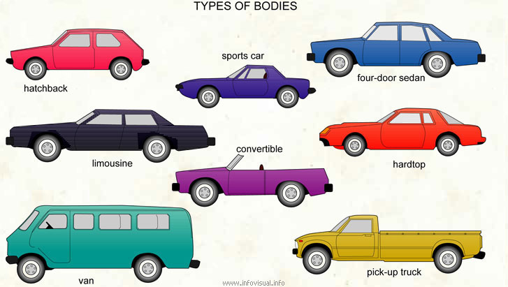
Specialisation
“is a” relationship (sub-typing)
Element B is a specialization of element A if and only if:
every instance of element B is also an instance of element A; and
there are instances of A which are not instances of B.
E.g.: Student can be specialised in male and female student
Opposite: Generalisation
Differentiate
disjoint or non-disjoint?
total and non-total?

Slide 23
Example
Using ‘football player’ provide examples for:
disjoint specializations
non-disjoint specializations
total specializations
non-total specializations
generalization

Slide 24
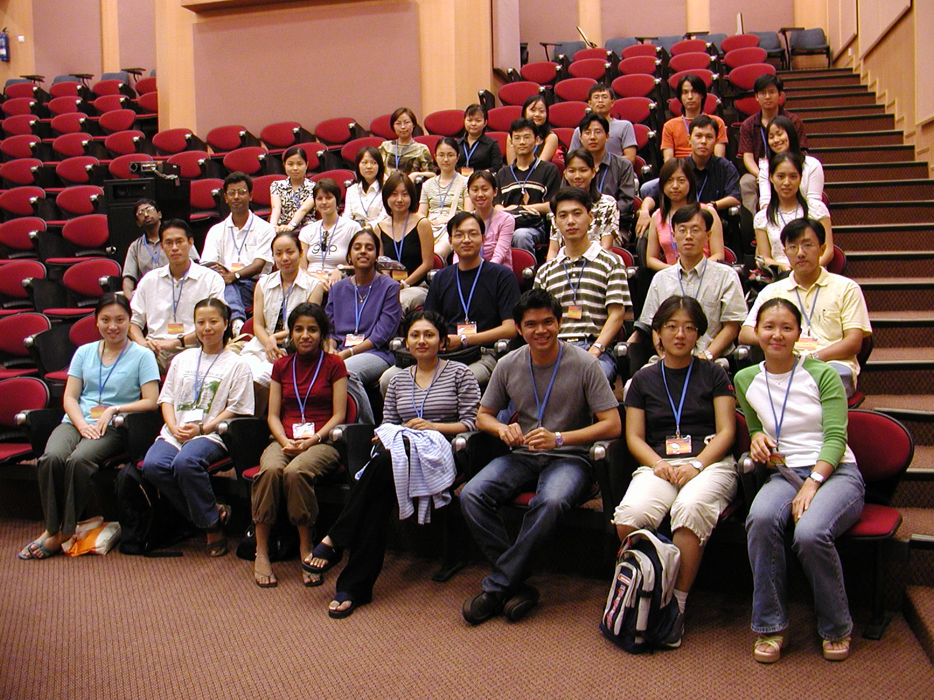
Aggregation
used to combine simple elements to more complex ones
“has a” relationship
does not imply ownership
e.g.: Students form a class. If a class is cancelled, its students continue to exist. A student can be enrolled in more than one class.
see also bundles

Slide 25
Composition
Like aggregation but implies ownership (“is part of”)
e.g. a university owns six faculties. If the university closes, the faculties will no longer exist. Each faculty belongs to exactly one university.
Containment is a special form of composition in which several instances of the same element are stored.
Heart “is part of” human being (composition)
Finger “is part of ” human being (containment)

Slide 26
Exam Question 2.2008
Use the following process model to provide an example for the difference between:
process generalization/specialisation
process aggregation/disaggregation.

Slide 27
Modelling for managing complexity
“Real” System
Model System
Generalization
Aggregation/
Composition
Elimination

Slide 28
References

Slide 29
Textbook (available as eBook from QUT Library)
Marlon Dumas, Marcello La Rosa, Jan Mendling, Hajo A. Reijers
Fundamentals of Business Process Management
Springer 2013
(Chapters 1-5)
http://fundamentals-of-bpm.org

Slide 30
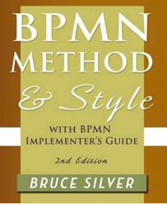
Recommendations
Bruce Silver
BPMN Method & Style (2nd Edition)
Cody-Cassidy Press 2012
(Except the part on executable process modelling)
www.bpmnstyle.com

Slide 31
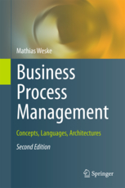
Recommendations
Matthias Weske
Business Process Management -
Concepts, Languages,
Architectures (2nd Edition)
Springer 2012
(Part II on Business Process Modelling)

Slide 32
Recommendations
Joerg Becker, Martin Kugeler,
Michael Rosemann (eds.)
Process Management
(2nd Edition)
Springer 2011
(Chapter 3)

Slide 33
A/Prof. Marcello La Rosa IS School Academic Director (Corporate Programs and Partnerships) BPM Discipline, IS School
Science & Engineering Faculty Queensland University of Technology 2 George Street Brisbane QLD 4000 Australia
p +61 (0)7 3138-9482 e m.larosa@qut.edu.au w www.marcellolarosa.com

