Slide 1
Indicadores de rendimiento de procesos
Gestión de Procesos y Servicios

Slide 2
Introduction
Specification
Graphical Modelling
Textual Modelling

Slide 3
Introduction
Specification
Graphical Modelling
Textual Modelling

Slide 4





Need to Measure
Notes:
En este contexto del ciclo de vida de la gestión del proceso de negocio, ya para poder llevar a cabo la mejora de la que hablábamos, es necesario medir.
De hecho, así lo indican actualmente, la mayoría de las metodologías y buenas prácticas que se utilizan en las organizaciones -lo contemplan como parte principal del ciclo de mejora

Slide 5
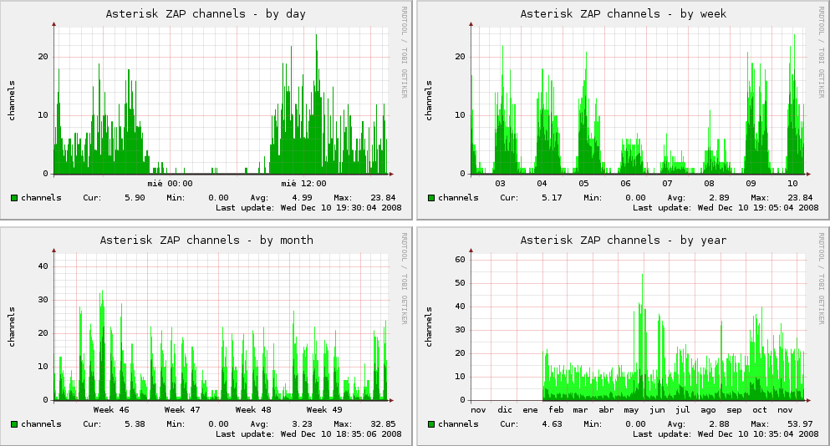
Measure for the Manager
To keep the business under control
BAM
Manager

Slide 6

Measure for Employees
To keep them motivated
Employee
If we get an EFQM +200 certification, then we will get an extra payment

Slide 7
Measure for Customers
To pay according to the QoS
Customer

Slide 8
Key Performance Indicator (KPI)
KPIs are quantiﬁable metrics that an organisation uses to measure performance in terms of meeting its strategic and operational objectives.
[A. Neely et al., 2005]
Notes:
Para medir, las empresas utilizan los KPIs…

Slide 9

The average class attendance should be increased by 15% during this course
Notes:
Un ejemplo de KPI en nuestro contexto de la educación podría ser

Slide 10


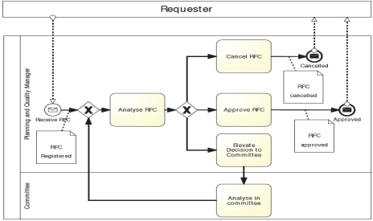
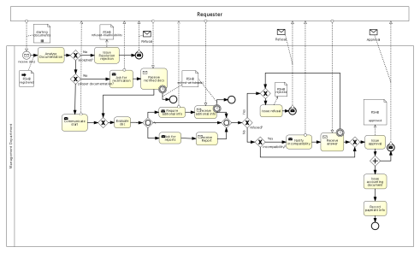
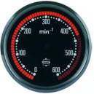
From KPI to PPI (Process Performance Indicator)
…
KPI₁
KPI_{n}
…
BP₁
BP_{n}
…
…
PPI₁₋₁
PPI_{1-n}
PPI_{n-1}
PPI_{n-n}
Notes:
Entonces tenemos organizaciones que definen sus KPIs para medir la evolución y cumplimiento de sus objetivos, pero además, cuando estas organizaciones están orientadas a procesos, es decir, describen sus actividades de negocio meidante procesos de negocio, también necesitan definir indicadores concretos a estos PPIs

Slide 11
Process Performance Indicator (PPI)
Quantifiable metrics that allow the evaluation of the efficiency and effectiveness of business processes. They can be measured directly by data that is generated within the process flow and are aimed at the process controlling and continuous optimization.
[G. Chase et al., 2011]
Notes:
Los PPIs pueden definirse como

Slide 12

RFC Management BP Diagram
Notes:
Este es el modelo de proceso de negocio modelado con una notación gráfica estándar, correspondiente al ejemplo anterior.
Vemos como se refleja de nuevo que el solicitante…

Slide 13


PPI Examples
delays caused by committee
number of RFCs per project
percentage of corrective changes from RFC approved
Notes:
Por ejemplo, en nuestro proceso podemos medir:

Slide 14
Guidelines for PPIs definition
SMART
Specific
Measurable
Less is more
Equilibrium between necessity and information overload
Don’t leave goals out of sight
Achievable
Relevant
Time-bounded
Notes:
No voy a medir nada si luego no puedo actuar (ejemplo mandar hacer mesa y medir en micras)
Medir cuesta:
Diseñarlas
Medir
Monitorizar
gestionar la monitorización
…

Slide 15
PPI vs KPIs
KPIs
PPIs
percentage of satisfied costumers
Profit per project
percentage of corrective changes from RFC approved
delays caused by committee
number of RFCs per project
Notes:
De forma que estos PPIs pueden entenderse como un caso particular de KPIs, por ejemplo un KPI es el % de clientes satifechos, y un PPI puede ser lo sretrasos causados por la decisión del comité

Slide 16
Reference models
There are also reference models and industry benchmarks that define performance metrics and set reference models for them.
Some examples:
  SCOR for supply-chain operations
  ITIL for IT processes
  DCOR for design-chain operations
  eTOM for telecom operations

Slide 17
Integrating the PPIM lifecycle into the BPM one
Evaluation
Design and
Identify PPI correlations, conflicts and predict future behaviour
Analysis
Design
Instrumen-tation
Computation
Evaluation
Define PPIs,
Connect with BP, design-time analysis
Calculate PPIs’ values and monitor PPIs
Implement measurement points
Enactment
Configuration
BPM lifecycle
PPIM lifecycle
Notes:
En esta diapositiva mostramos cómo llevar a cabo esa integración.
En burdeos tenemos el BPM lifecycle, en amarillo el de los Ppis

Slide 18
Introduction
Specification
Graphical Modelling
Textual Modelling

Slide 19
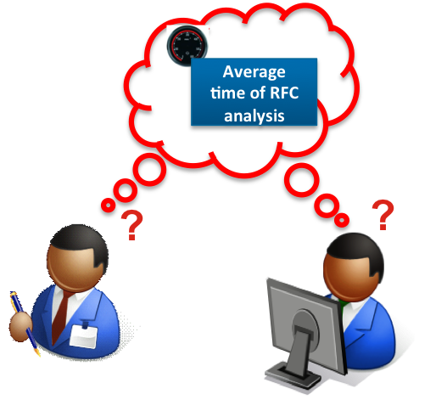
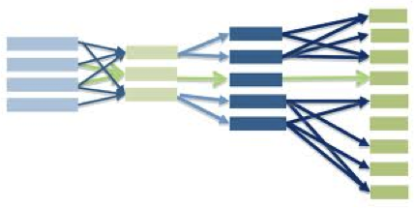

Desiderata for the PPI Specification
Understandable
SMART
Specific
Measurable
Achievable
Relevant
Timed
Traceable to BPs
Automatically processable

Slide 20
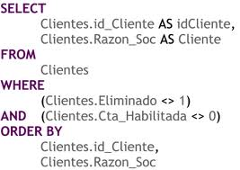
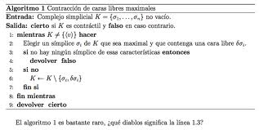
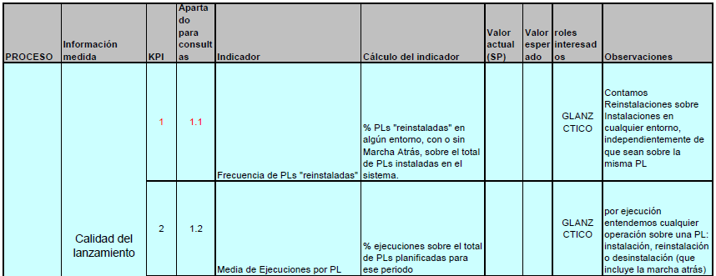
Common mechanisms to specify PPI
Low level -
implementation perspective
Informal -
natural language
Notes:
Esta es la situación ideal, sin embargo, en la actualidad, lo que nos hemos encontrado después de analizar varias organizaciones cercanas y tras un estudio de la literatura relacionada

Slide 21
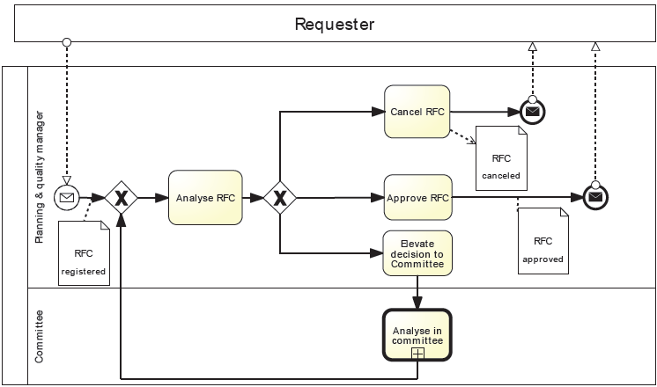

Ambiguity and Incompleteness
Duration of the analysis activity
When
Which analysis activity

Slide 22
Traceability
?
?
Way of defining a PPI
?
?
Notes:
Traceability:
difficulty to maintain the coherence across both worlds (BPs and PPIs), e.g. what happens if an activity is removed and there exists a PPI that is only defined over that activity?, or What happens if a PPI is defined by referencing an activity whose name does not correspond to the one in the BP?
difficulty to instrument the process

Slide 23

Understandability
?
?
Business manager
System architect
Processable vs understandable

Slide 24



Visual Gap
Way of defining a PPI
Comprehensive views
Partial views
Notes:
Visiual gap: BPs usually expressed in a graphical notation to ease communication, why not with PPIs? Partial views

Slide 25

BPs
PPIs

Slide 26
Introduction
Specification
Graphical Modelling
Textual Modelling

Slide 27

Visual notation
Integrated with BPMN

Slide 28



Measures
What to measure
Time
Base Measure
PPI
Count
Aggregated Measure
State
Condition
SUM
Derived Single-Instance Measure
Data Property Condition
SUM
Derived Multi-Instance Measure
Data content
Connectors
Time connectors
Aggregates
Uses
Applies to
isGroupedBy

Slide 29
Notación para definir indicadores
Medida básica o de instancia (Base Measure): Mide cada instancia (ejecución) del proceso por separado.
Medida agregada o de proceso (Aggregated Measure): Mide distintas instancias del proceso agregándolas con una función de agregación: Min, Max, Avg, Sum

Slide 30
Notación para definir indicadores
Medida derivada (Derived Measure): Realiza una operación matemática sobre una o varias medidas. Pueden ser de instancia o de proceso.

Slide 31
Tipos de medidas (básicas y agregadas)
Tiempo
Conteo
Condición sobre elementos
Condición sobre datos
Contenido de datos

Slide 32
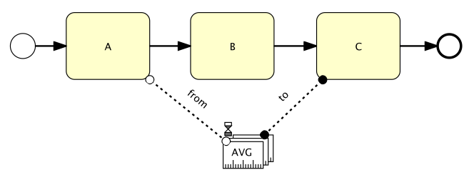
Medida de tiempo
Tiempo medio transcurrido entre inicio de actividad A y fin actividad C

Slide 33



Tipos de conectores
De tiempo (para medidas de tiempo)
  From (Blanco)
  To (Negro)
  Círculo blanco mide inicio (actividad, pool, etc)
  Círculo negro mide final (actividad, pool, etc)

Slide 34
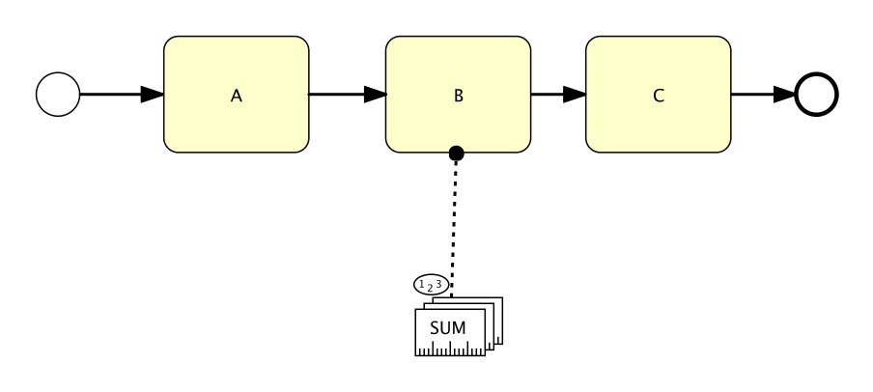
Medida de conteo
Suma de veces (en todas las ejecuciones) que se ejecuta la actividad B

Slide 35
Tipos de conectores
Applies to: Indica el elemento que se está midiendo.
  Al igual que el de tiempo se puede indicar si se quiere contar al principio o al final de la actividad:
    Círculo blanco mide inicio
    Círculo negro mide final

Slide 36
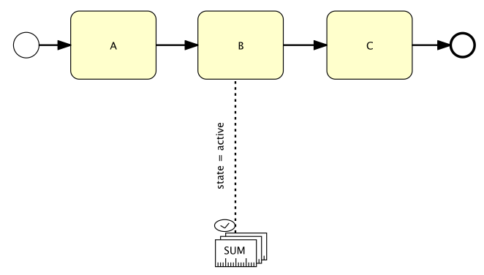
Medida de condición de actividades
Suma el número de actividades de tipo B que se están ejecutando en este momento

Slide 37
Tipos de conectores
Applies to: Indica el elemento que se está midiendo. La etiqueta debe ser un posible estado del elemento.
  Los estados para una actividad y un pool son: ready, active, withdrawn, completing, completed, failing, failed, terminating, terminated, compensating, compensated
  Los estados para un evento son: none, waiting, completed

Slide 38
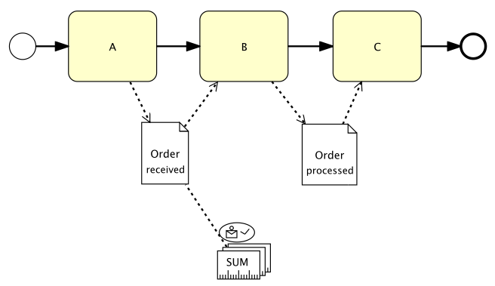
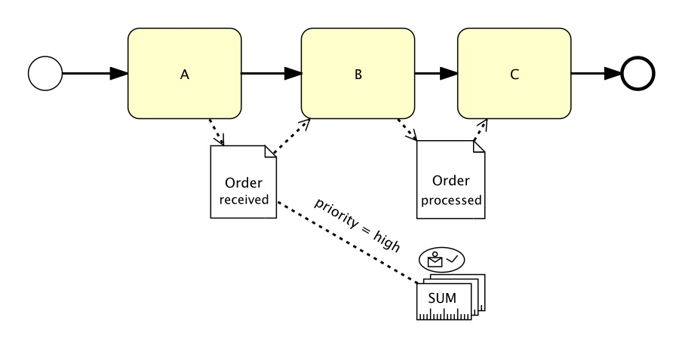
Medida de condición de datos
Suma de órdenes que se encuentran en estado recibida
Suma de órdenes con prioridad “high”

Slide 39
Tipos de conectores
Applies to: Indica el dato que se está midiendo. La etiqueta debe ser un estado del dato o una condición sobre una propiedad del dato.

Slide 40
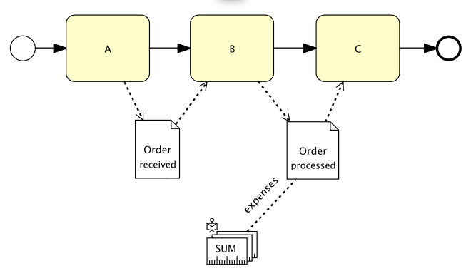
Medidas de contenido de datos
Suma de gasto incluido en cada orden

Slide 41
Tipos de conectores
Applies to: Indica el dato que se está midiendo. La etiqueta debe ser la propiedad del dato cuyo valor se pretende medir

Slide 42

Otros tipos de conectores
isGroupedBy (para agregaciones): Permite agrupar la medida por una determinada propiedad.
Aggregates (para agregaciones): Conecta el tipo de medida agregado genérico con la medida de instancia que agrega

Slide 43
Tipos de conectores
Uses (para medidas derivadas): Indica las medidas que usa una medida derivada.
  Se puede nombrar con variables a las medidas y luego poner la fórmula en la medida derivada.

Slide 44
Some guidelines
What to measure?
  Am I measuring time, counts, contents of data…?
  Am I measuring from one instance or aggregating data from several instances? Which kind of aggregation should I use?
How to measure?
  Which elements of the process needs to be measure? Which is the formula of the derived measure?
When to measure?
  Which process instances are involved in the measure (those in the last month, in the last year, the last 100 instances?)
Which is the target?

Slide 45
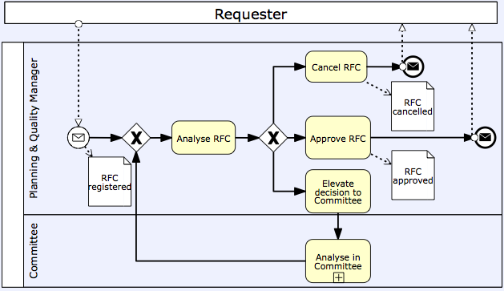
I want to know the delays caused by committee

Slide 46
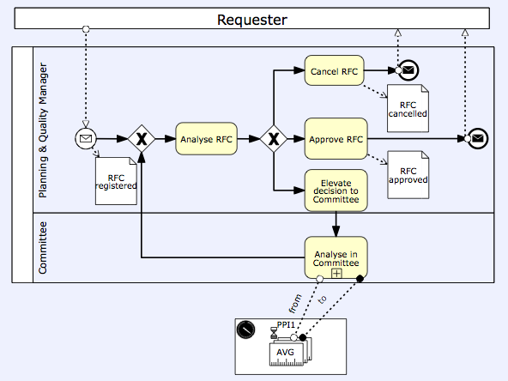
I want to know the delays caused by committee
What To Measure?
Time

Slide 47
I want to know the delays caused by committee
What To Measure?
Aggregating several Instances: AggregatedMeasure
What aggregation?: Average (AVG)

Slide 48
I want to know the delays caused by committee
2. How To Measure?
Time connectors

Slide 49
I want to know the delays caused by committee
3. When To Measure?
Analysis period | Annual

Slide 50
I want to know the delays caused by committee
4. Which is the target?
Goal | < 5 working days

Slide 51
I need to count the number of RFCs by project

Slide 52
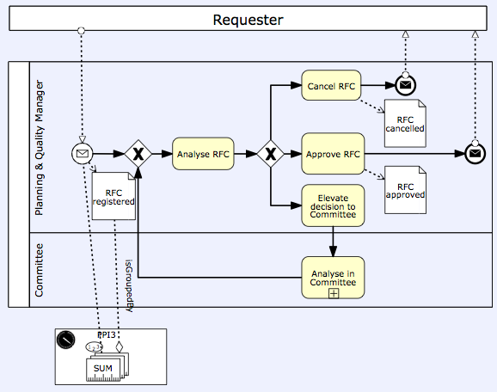
I need to count the number of RFCs by project
What To Measure?
Conteo

Slide 53
I need to count the number of RFCs by project
What To Measure?
Agregando varias instancias
¿Qué agregación?: Suma (SUM)

Slide 54
I need to count the number of RFCs by project
2. How To Measure?
Applies to connectors
Grouped by…

Slide 55
I need to count the number of RFCs by project
3. When To Measure?
Analysis period | Annual

Slide 56
I need to count the number of RFCs by project
4. Which is the target?
Goal | < 20 RFCs

Slide 57
I want to know the percentage of corrective changes out of the approved RFCs

Slide 58
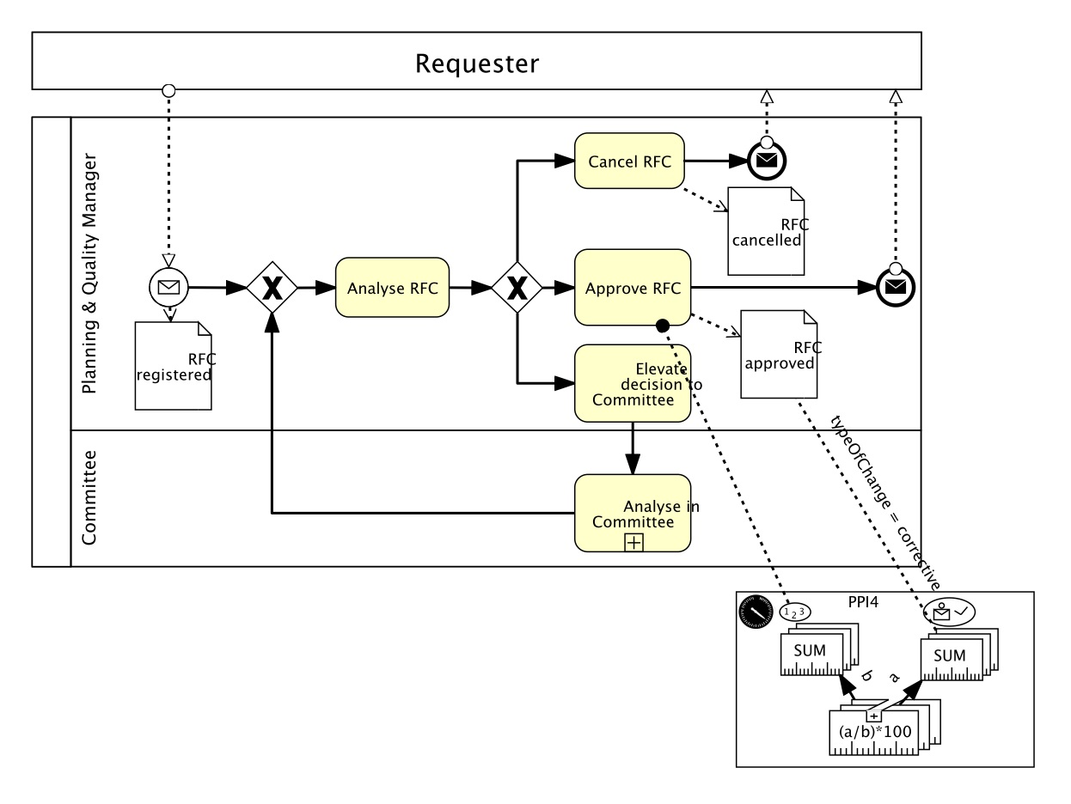
I want to know the percentage of corrective changes out of the approved RFCs
Medida agregada que suma las RFCs con cambios correctivos
Medida agregada que suma la cuenta de Approve RFC
Función matemática sobre varias medidas

Slide 59
Introduction
Specification
Graphical Modelling
Textual Modelling

Slide 60
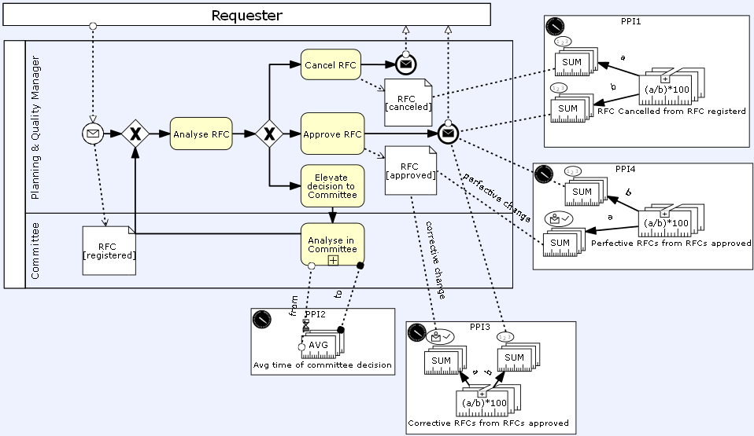
PPINOT maybe not enough
Scalability
?
Learning curve
Business manager

Slide 61
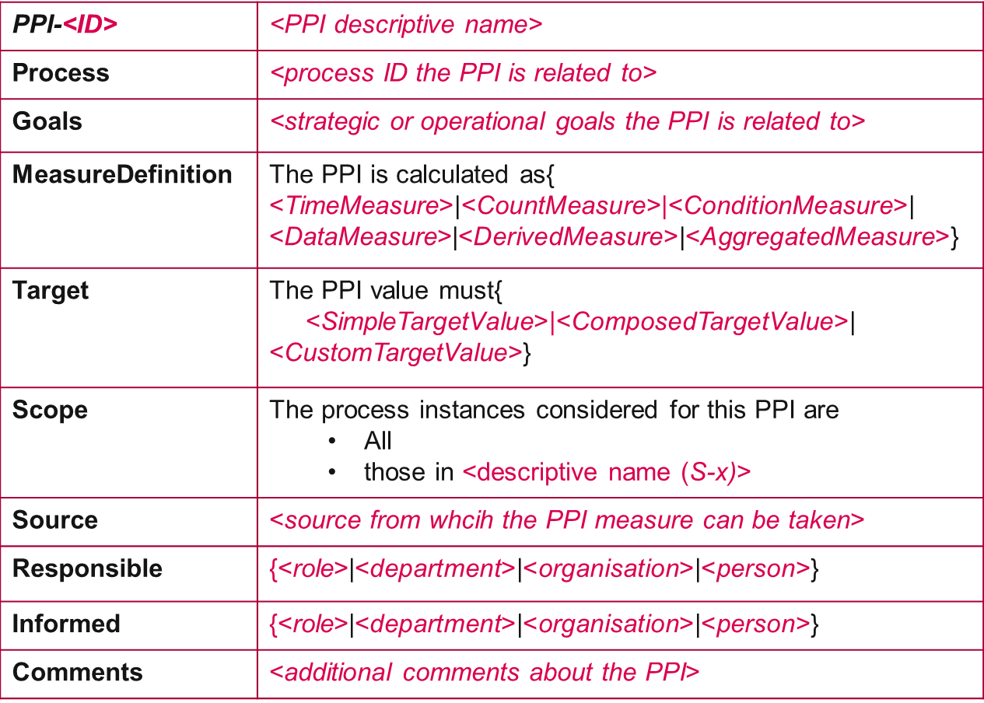
Templates
Helps to structure information
Serves as a guide
Uses (structured) natural language

Slide 62
Linguistic patterns
Easier and faster than writing whole paragraphs from scratch
The PPI value must be greater than [or equal to] <lower bound>
Sucessfully used in RE
Fills placeholders in prewritten sentences

Slide 63
PPI-template
PPI-<ID> | <PPI descriptive name>
Process | <process ID the PPI is related to>
Goals | <strategic or operational goals the PPI is related to>
MeasureDefinition | The PPI is calculated as{ <TimeMeasure>|<CountMeasure>|<ConditionMeasure>| <DataMeasure>|<DerivedMeasure>|<AggregatedMeasure>}
Target | The PPI value { <SimpleTargetValue>|<ComposedTargetValue>| <CustomTargetValue>}
Scope | The process instances considered for this PPI are All those in <descriptive name (S-x)>
Source | <source from whcih the PPI measure can be taken>
Responsible | {<role>|<department>|<organisation>|<person>}
Informed | {<role>|<department>|<organisation>|<person>}
Comments | <additional comments about the PPI>
R
S
M
A
T

Slide 64
PPI-template Example
PPI-005 | Average time of RFC analysis
Process | Request for change (RFC)
Goals | BG-002: Improve customer satisfaction BG-014: Reduce RFC response time
MeasureDefinition | The PPI is calculated as the average of the duration between the time instants when activity RFC analysis becomes active and when activity RFC analysis becomes completed
Target | The PPI value must be lower than or equal to 1 working day
Scope | The process instances considered for this PPI are those in Last 100 instances scope
Source | Event logs of BPMS
Responsible | Planning and quality manager
Informed | Chief Information Officer (CIO)
Comments | Most RFCs are created after 12:00

Slide 65
L-Patterns for PPI Specification
Time Measure
the duration between the time instants when <event1> and when <event2>
the duration between the time instants when activity RFC analysis changes to state active and when activity RFC analysis changes to state completed
Where <event> is defined as:
{<BP element type> <BP element name> changes to state <BP state>|
event <BP event name> is triggered}
Count Measure
the number of times <event1>
the number of times activity Analyse RFC changes to state completed

Slide 66
L-Patterns for PPI Specification
Condition Measure
<BP element type> <BP element name> {is currently | has finished} in state <BP state>
data object <data object name> satisfies: <condition on data object properties>
activity Analyse in committee is currently in state active
data object RFC satisfies: priority = high
Data Measure
the value of property
<property name> of data object <data object name>
the value of property
affected departments of data object RFC

Slide 67
L-Patterns for PPI Specification
Derived Measure
the function <expression over x₁ … x_{n}>, where {<x_{i}> is <Measure_{i}>}_{i=1..n}
the function a/b*100 , where a is the number of times data Object RFC changes to state approved and r is the number of times data Object RFC changes to state registered
Aggregated Measure
the {sum|maximum|minimum|average} of <Measure>
the average of the duration between the time instants when activity RFC analysis changes to state active and when activity RFC analysis changes to state completed

Slide 68
Scope Template
S-<ID> | <Scope descriptive name>
Conditions | This scope inlcudes [not] <NumberOfInstancesCondition> [and | or] [not] <ProcessInstanceStateCondition> [and | or] [not] <TemporalCondition>
Periodicitiy | The set of process instances is re-calculated daily {every <d> days | every day} weekly on <day of week> monthly on {<day of month> | the <n^{th}> <day of week>} yearly on {<month> <day of month> | the <n^{th}> <day of week> of <month>}
Comments | <additional comments about the Scope>
Example
S-1 | Holydays period(<year>)
Conditions | This scope inlcudes process instances in state completed and started after of at 23-12-<year> and finished before or at 04-01-<year+1> or started after of at 01-08-<year+1> and finished before or at 31-08-<year+1>
Periodicitiy | The set of process instances is re-calculated yearly on September the first

Slide 69
Summary and literature

Slide 70
Summary
PPIs are becoming more and more important
PPI specification is an ongoing research area
PPINOT is a novel, comprehensive visual notation
PPINOT needs to be complemented with textual notation
PPINOT is 100% Spanish, from Universidad de Sevilla

Slide 71
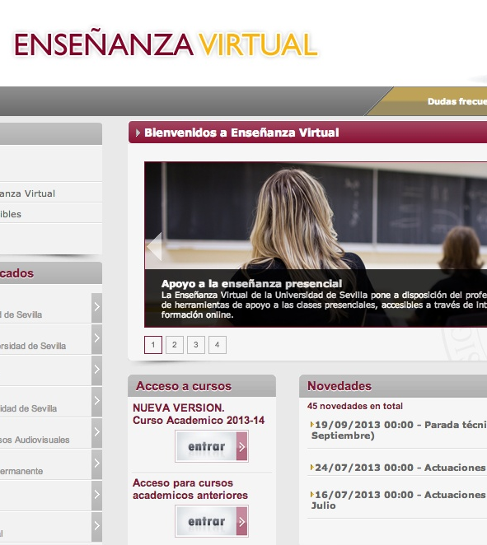
Enseñanza Virtual
Una relación de documentos incluidos en la carpeta “Referencias de indicadores”

Slide 72
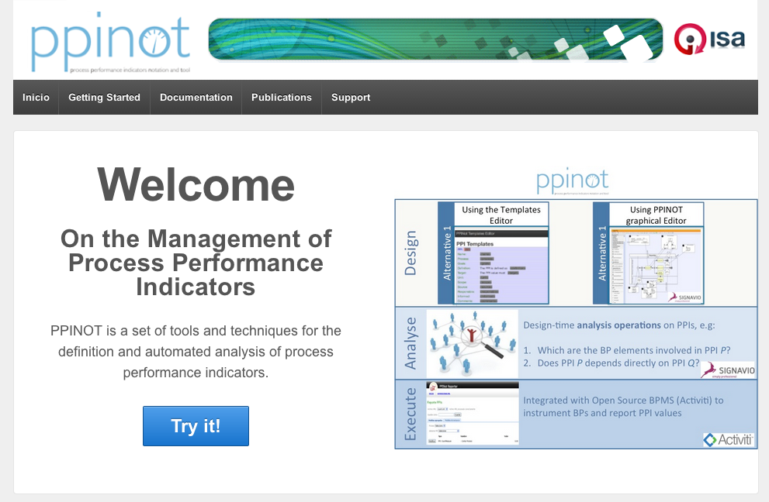
References
Available at http://www.isa.us.es/ppinot

